Slide 1
Pinball: A Cryogenic Predecoder for Quantum Error Correction Decoding Under Circuit-Level Noise
Alexander Knapen
Coauthors: Guanchen Tao, Jacob Mack, Tomas Bruno, Mehdi Saligane, Dennis Sylvester, Qirui Zhang, Gokul Subramanian Ravi
This material is based upon work supported by the U.S. Department of Energy, Office of Science, Office of Advanced Scientific Computing Research, Accelerated Research in Quantum Computing under Award Number DE-SC0025633. This research used resources of the National Energy Research Scientific Computing Center, a DOE Office of Science User Facility supported by the Office of Science of the U.S. Department of Energy under Contract No. DE-AC02-05CH11231 using NERSC award ASCR-ERCAP0033197.

Slide 2
Overview
Background: Surface Code Decoding + Cryogenic Predecoding
Pinball Predecoding Algorithm
Hardware Implementation
Performance Results

Slide 3
Surface Code Decoding

Slide 4
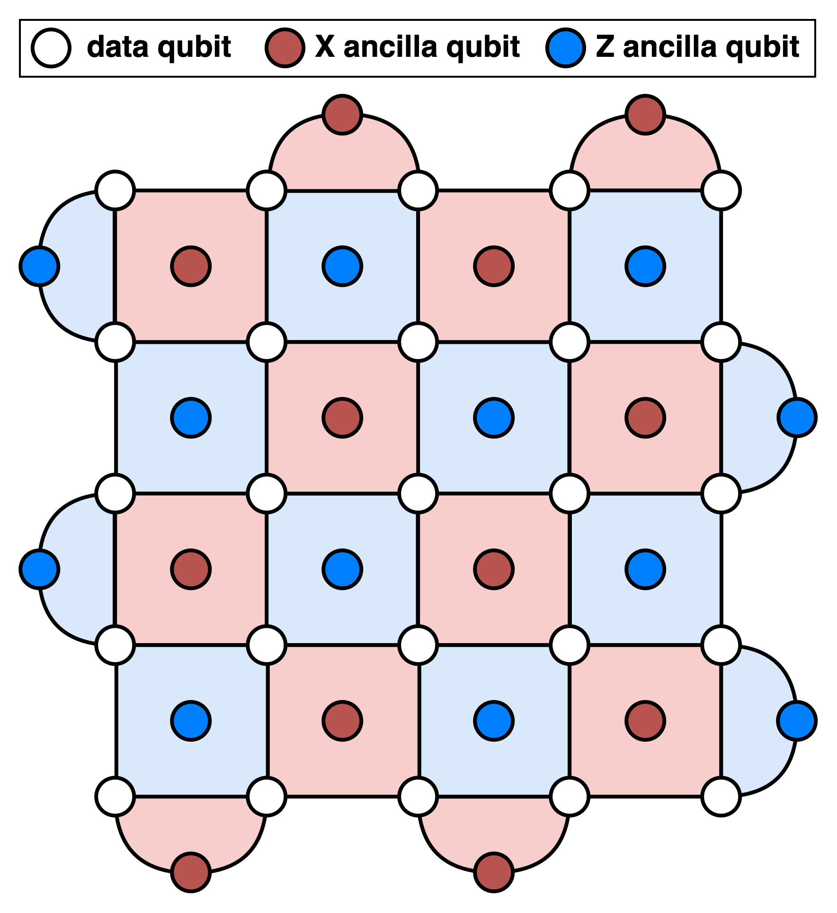
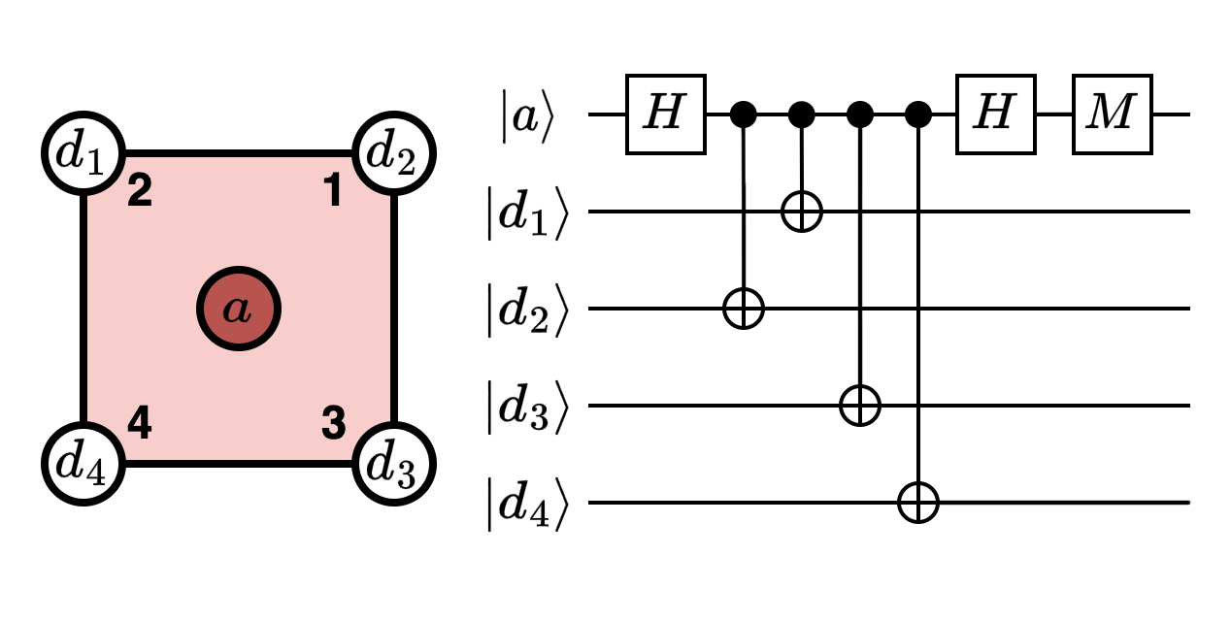
Quantum Error Correction
Surface Code
Redundantly group multiple, error prone physical qubits into a single, robust logical qubit
1) Data Qubits: store computational state being computed on
2) X Ancilla Qubits: detect parity of Z errors on neighboring data qubits
3) Z Ancilla Qubits: detect parity of X errors on neighboring data qubits
d = 5

Slide 5
Quantum Error Correction
Surface Code
Redundantly group multiple, error prone physical qubits into a single, robust logical qubit
1) Data Qubits: store computational state being computed on
2) X Ancilla Qubits: detect parity of Z errors on neighboring data qubits
3) Z Ancilla Qubits: detect parity of X errors on neighboring data qubits
d = 5
Syndrome ≡ binary vector of ancilla measurement outcomes (1 = “active”, 0 = “inactive”)

Slide 6
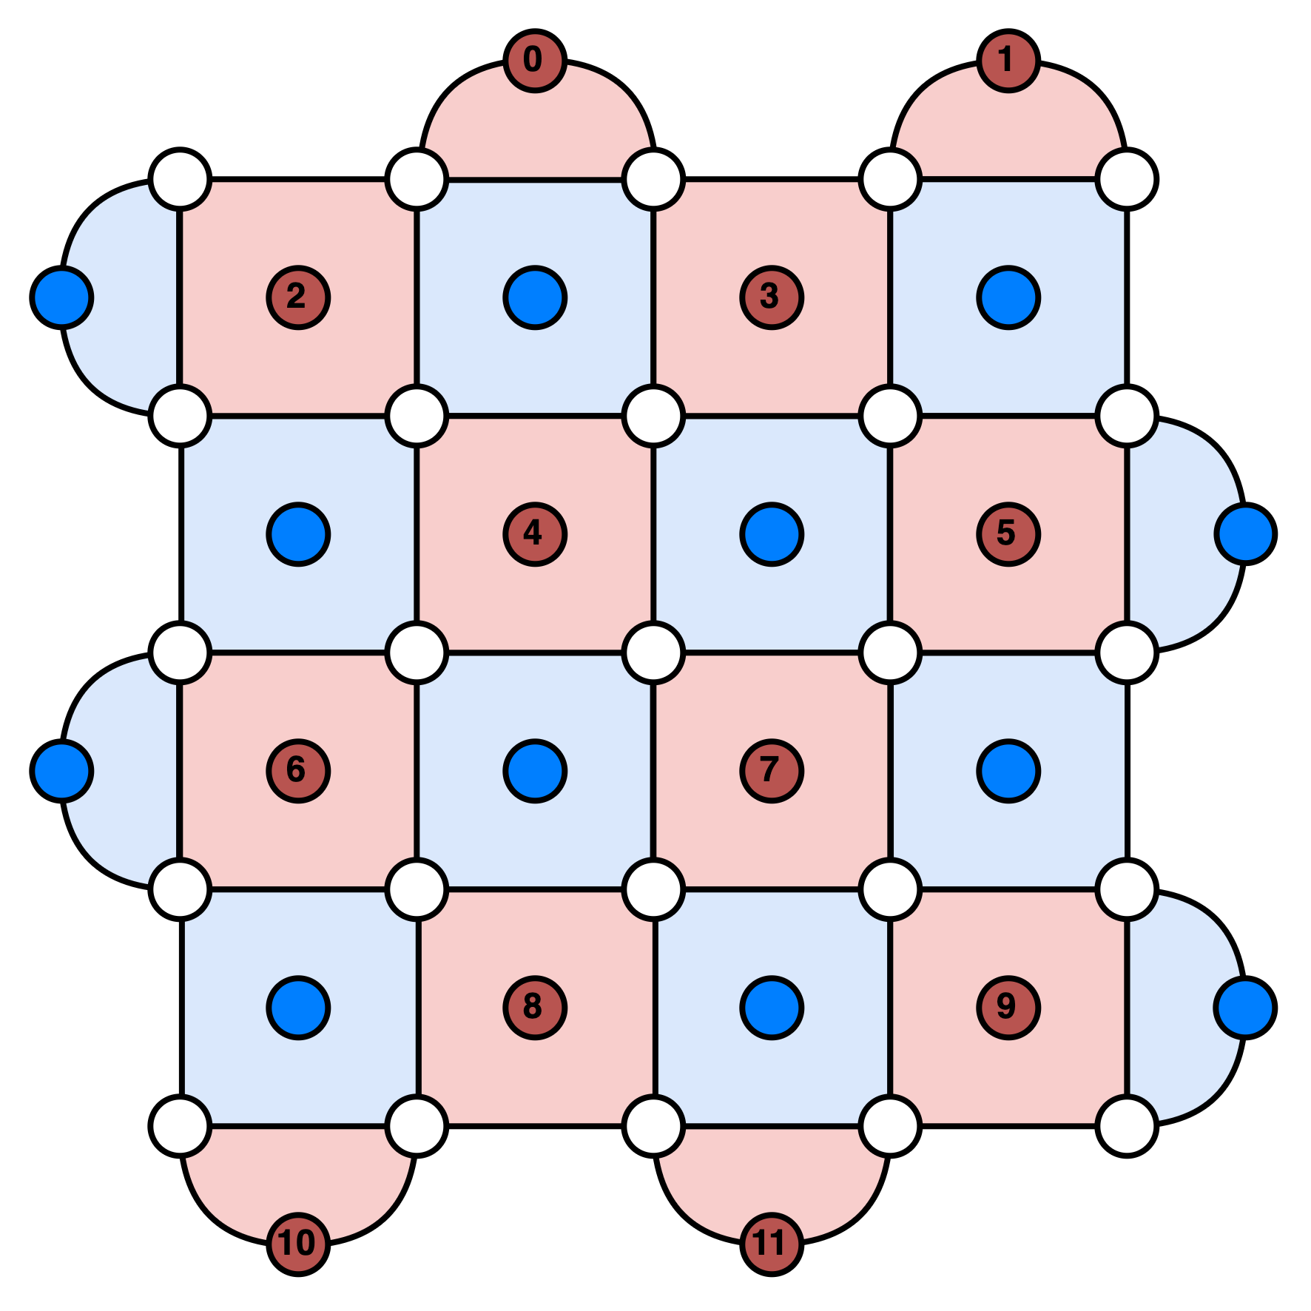
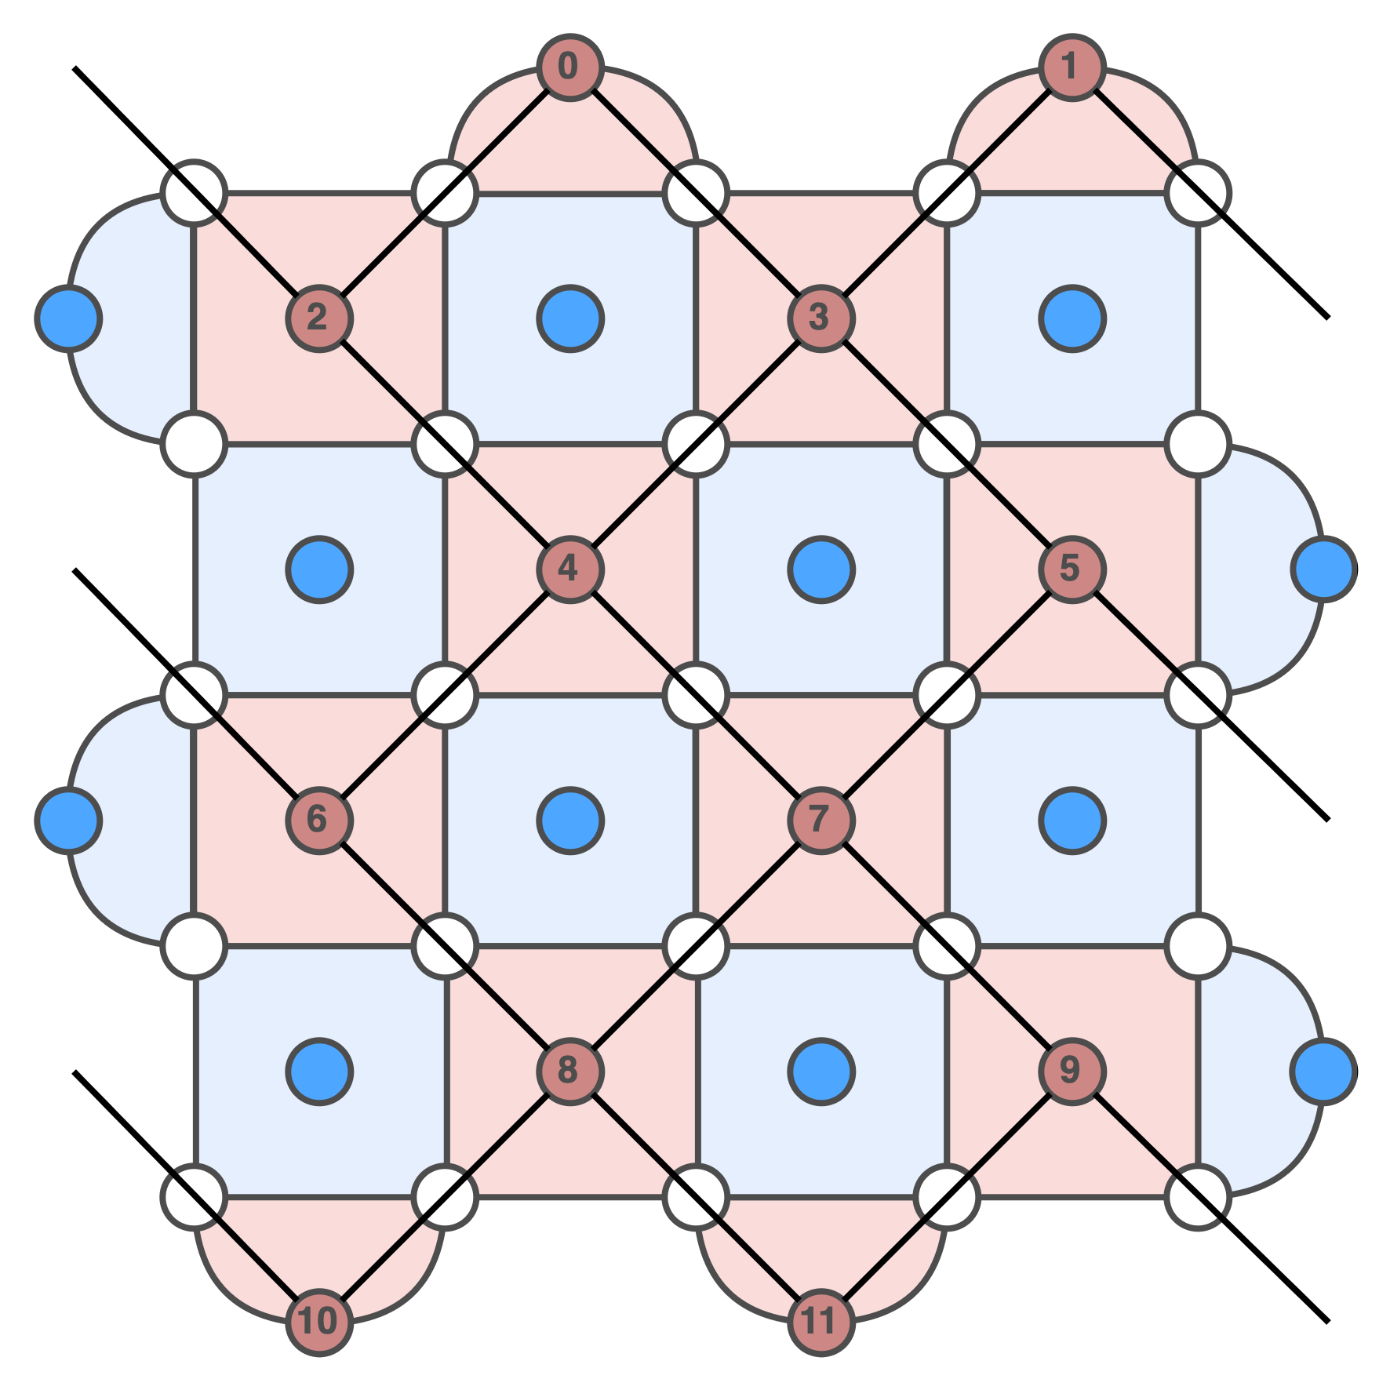
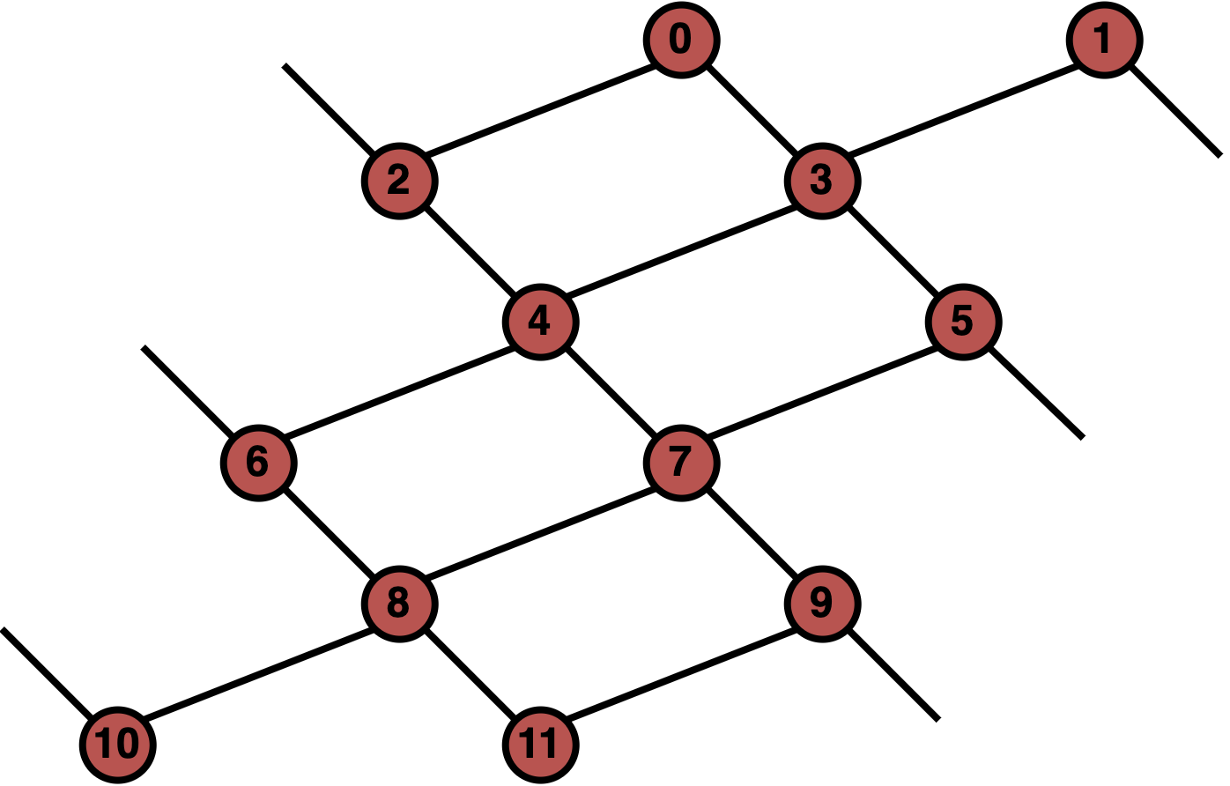
Surface Code Decoding
Decoding Graph Representation
Vertices ≡ syndromes
Edges ≡ errors flipping syndromes at their endpoint(s)
Classical Decoding Algorithm: find paths that connect active syndromes

Slide 7

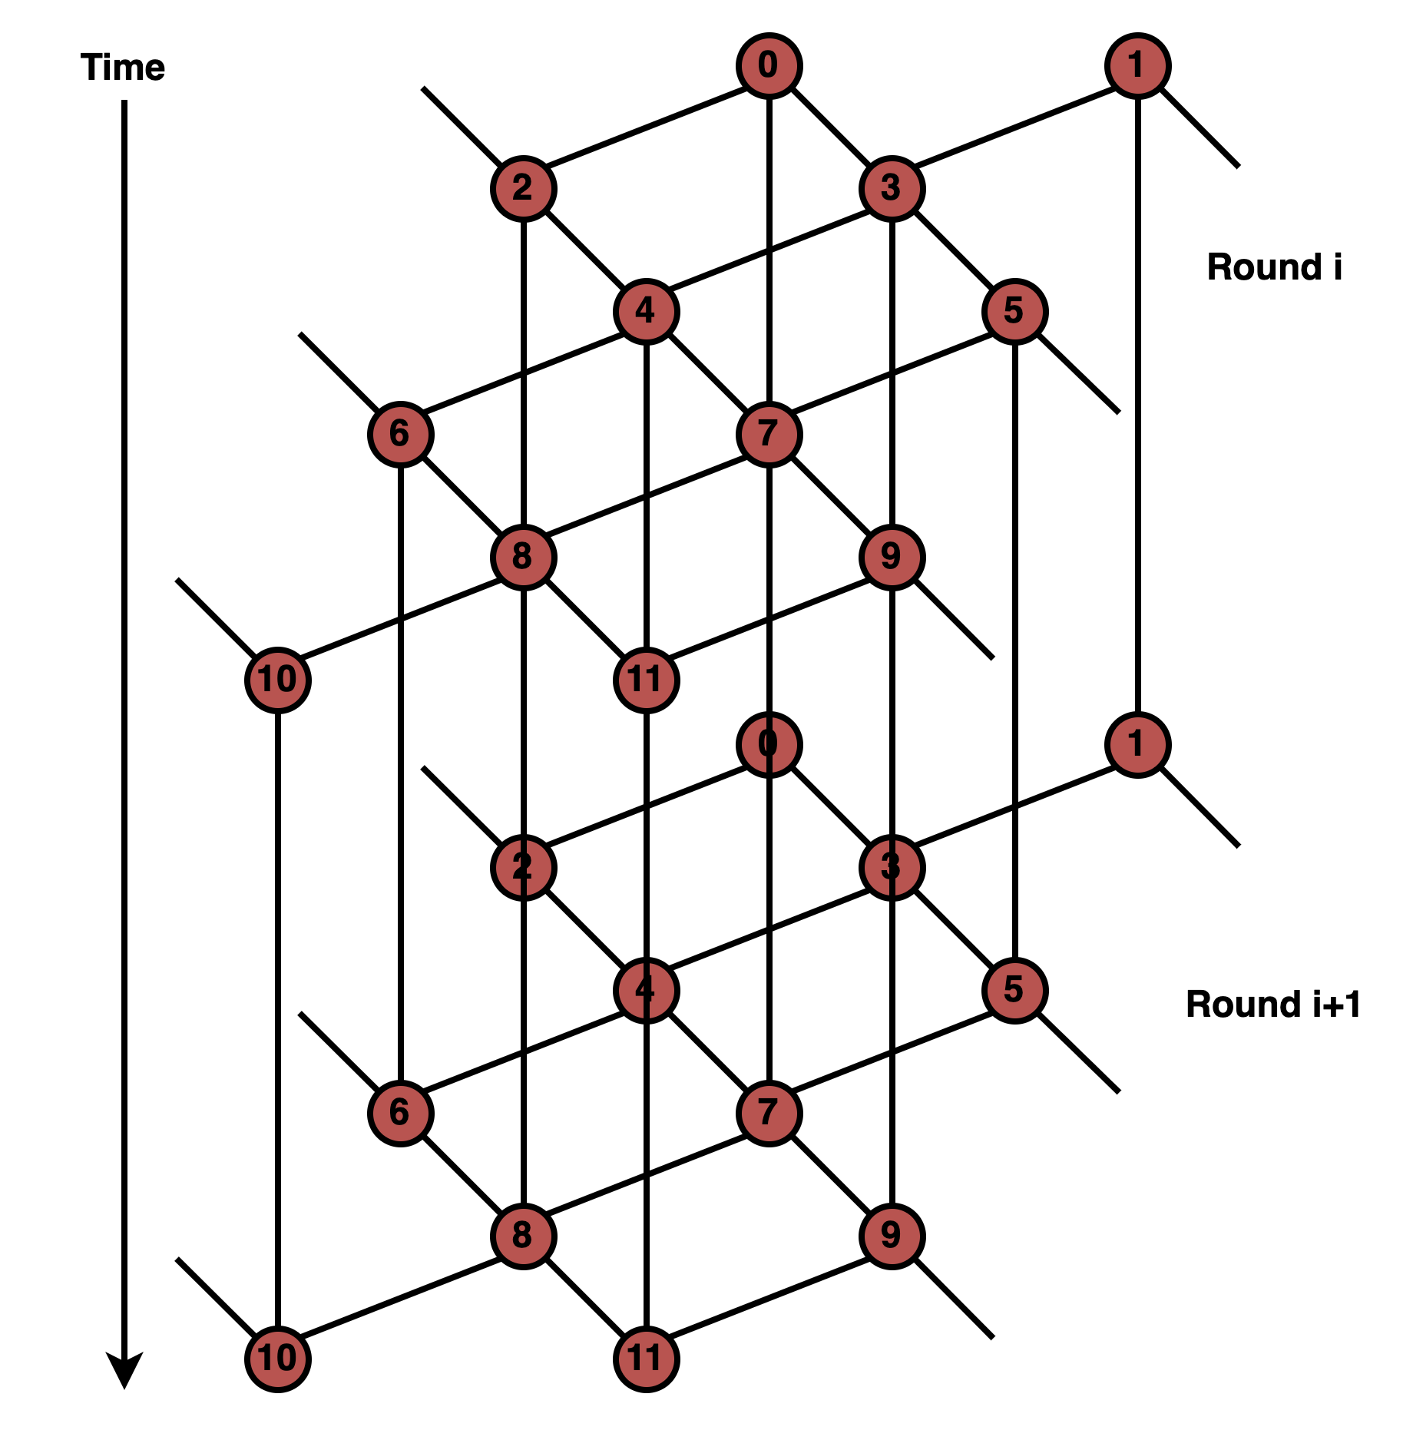
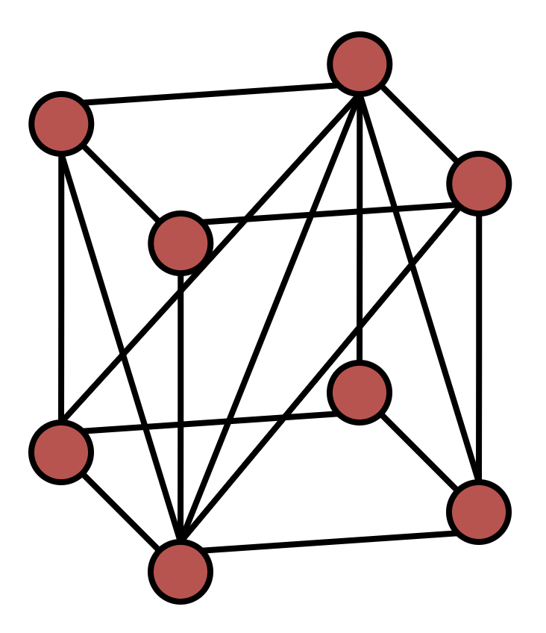
Surface Code Decoding
Noise model changes the complexity of the decoding graph
Code Capacity: each data qubit randomly flips with some probability
Phenomenological: accounts for imperfect measurements
Circuit-Level: accounts for imperfect gates in syndrome measurement circuits
1
2
3
Space-like +
Time-like +
Spacetime-like Errors
Space-like Errors
Space-like + Time-like Errors

Slide 8
Cryogenic Predecoding

Slide 9
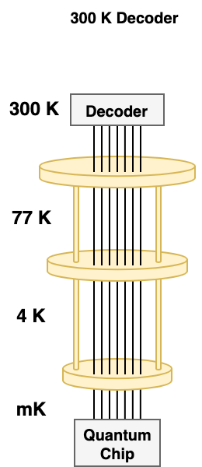
System-Level Decoding Challenges
1) Syndrome Data Volume
2) Decoding Complexity
3) Strict Real-Time Constraints

Slide 10
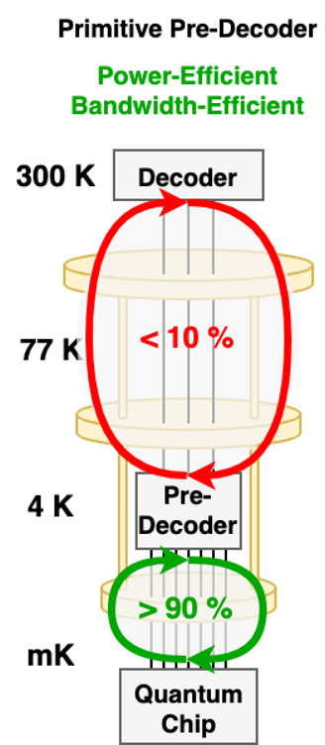
System-Level Decoding Challenges
1) Syndrome Data Volume
2) Decoding Complexity
3) Strict Real-Time Constraints
Cryogenic Predecoding
> 90% of error chains are short (length ≤ 1)
Use lightweight, locally accurate logic to:
1) Decode common length-1 chains at cryo
2) Detect rare, longer chains and offload to RT
State-of-the-art: Clique

Slide 11
Clique Limitations
Tailored to phenomenological noise

Slide 12
Clique Limitations
Logical Error Rate
Tailored to phenomenological noise
⇒ Limited system-level performance benefits in real-world
quantum systems

Slide 13
Clique Limitations
Tailored to phenomenological noise
⇒ Limited system-level performance benefits in real-world
SFQ Implementation
⇒ Relative lack of maturity precludes design evaluation + optimization

Slide 14
Pinball Predecoding Algorithm

Slide 15
Pinball Predecoder
Predecoding Primitive: for every pair of neighboring syndromes in the decoding graph, apply a correction on
the edge between them if they’re both active

Slide 16
Pinball Predecoder
Predecoding Primitive: for every pair of neighboring syndromes in the decoding graph, apply a correction on
the edge between them if they’re both active
Need to Cover:
Space-like Edges
Time-like Edges
Spacetime-like Edges
How do we know which data qubit(s) to correct for each edge?

Slide 17
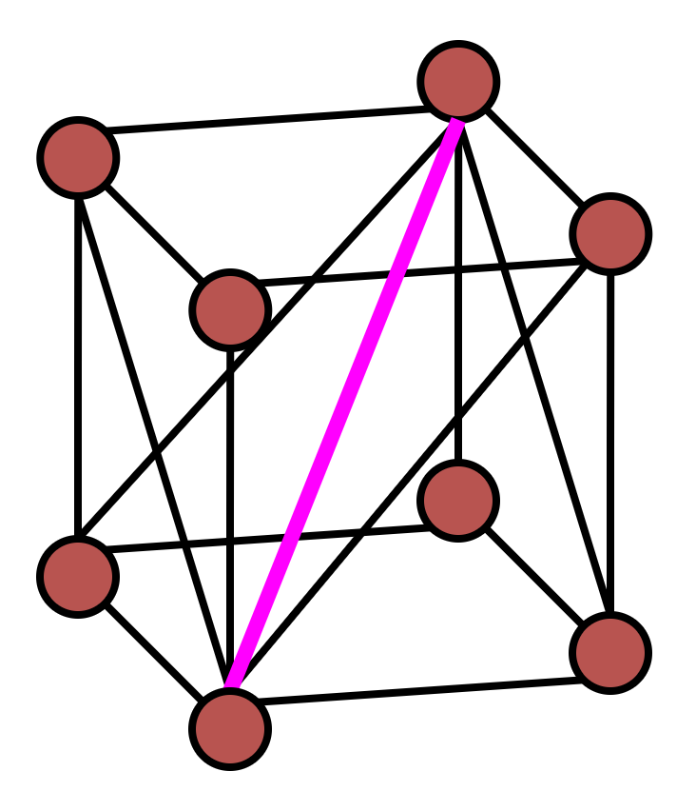
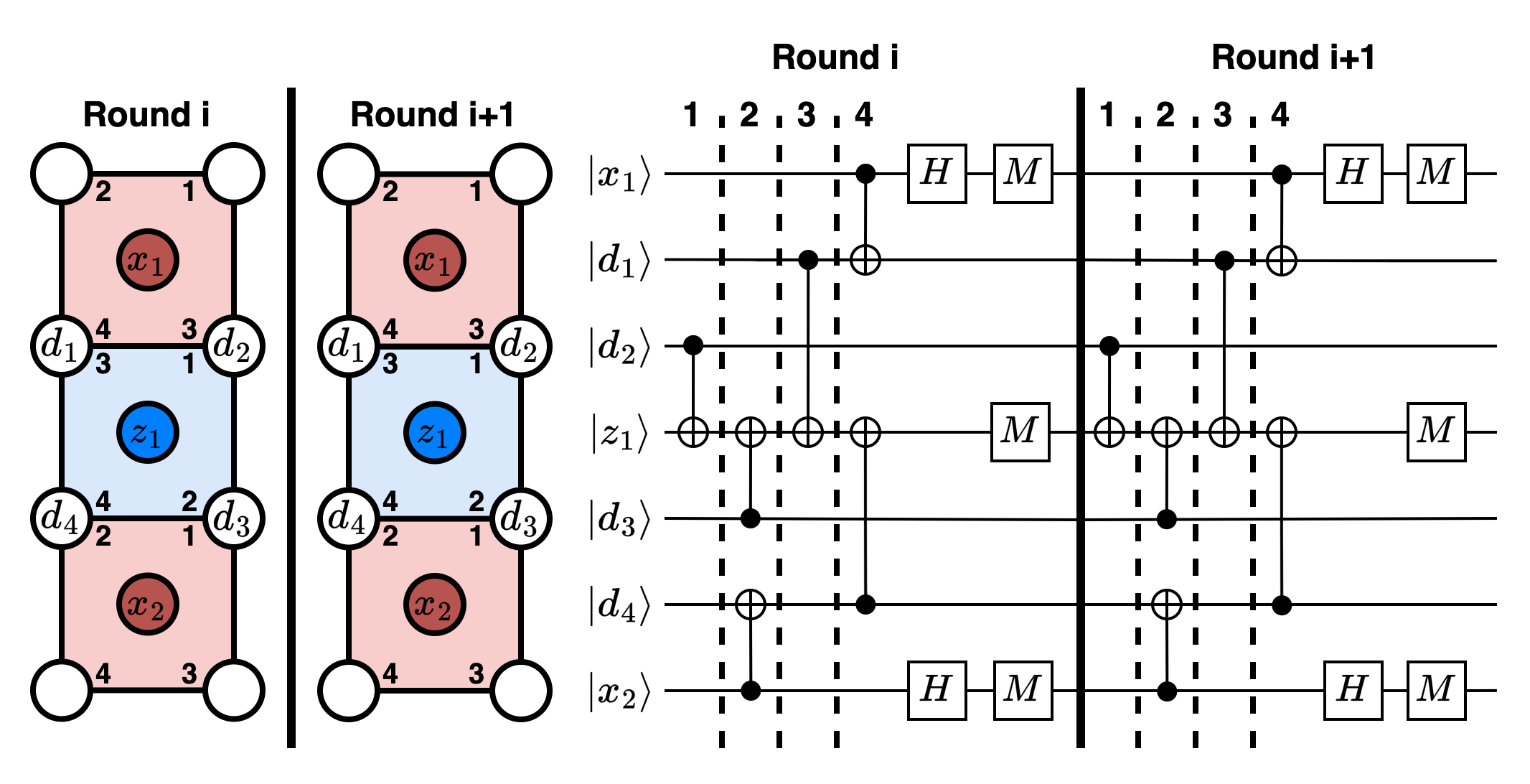
Deriving Hook-like Edges

Slide 18
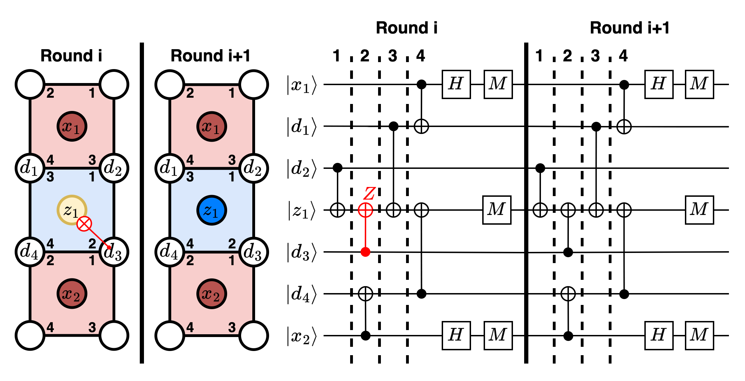
Deriving Hook-like Edges

Slide 19
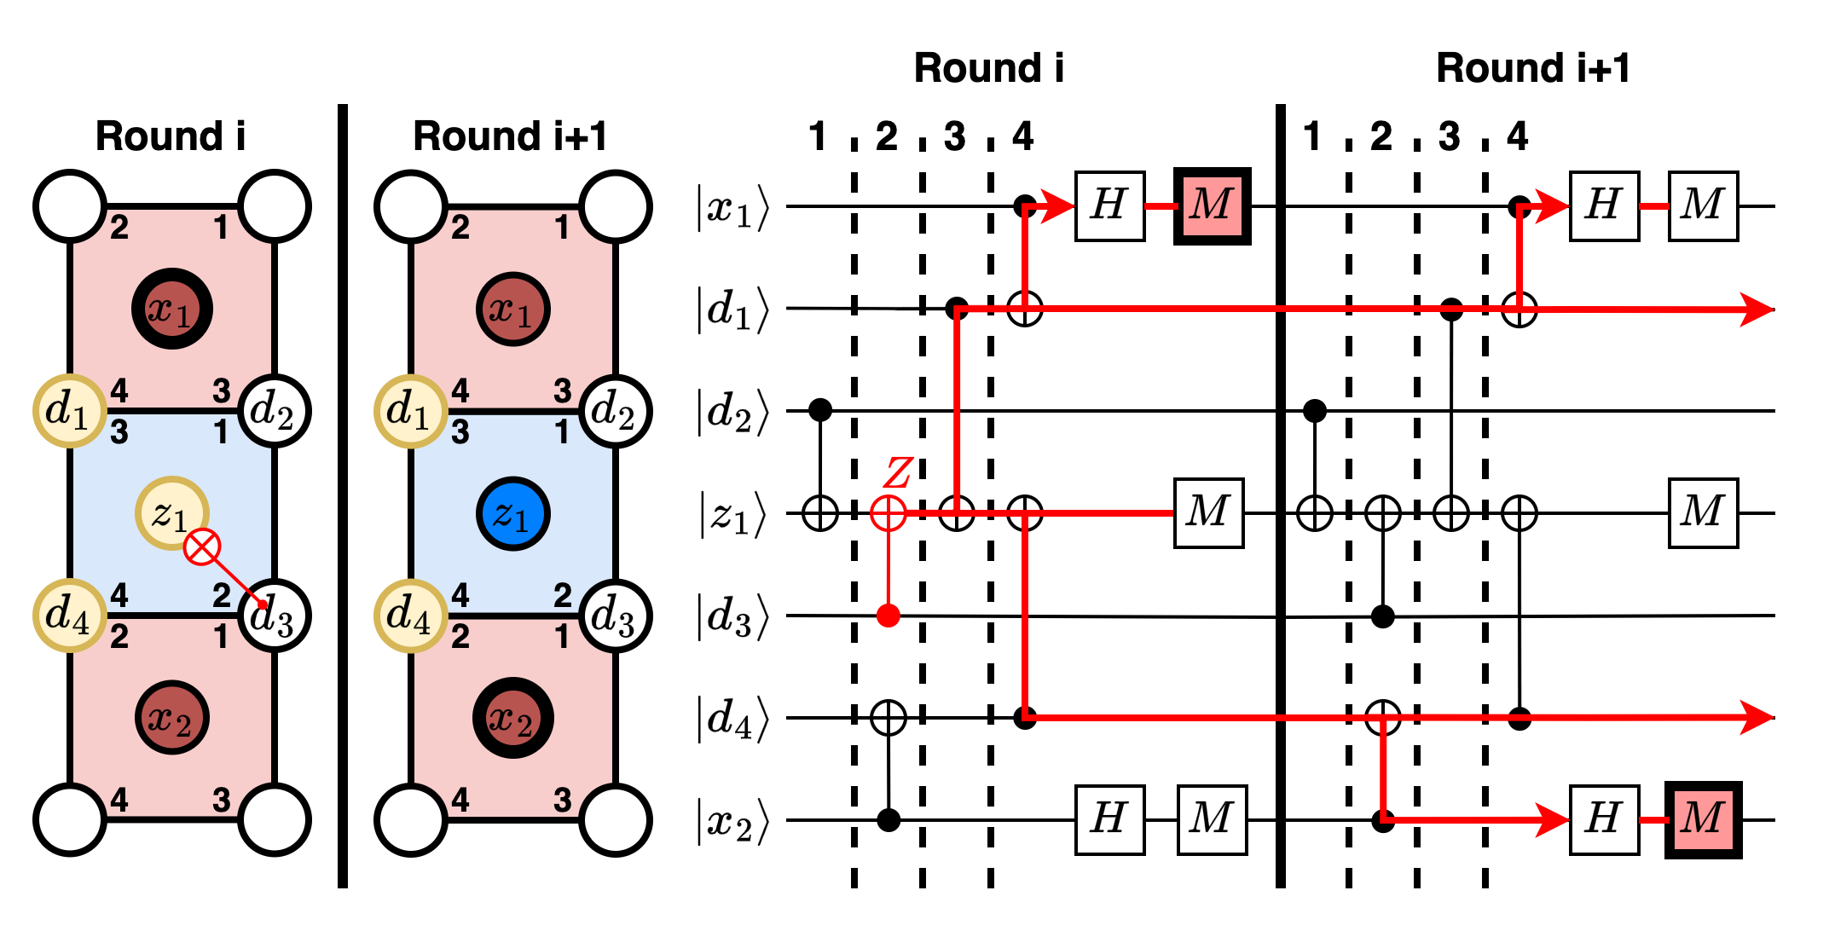
Deriving Hook-like Edges
Correct the two data qubits along the chain between the pair of active syndromes in the surface code lattice

Slide 20
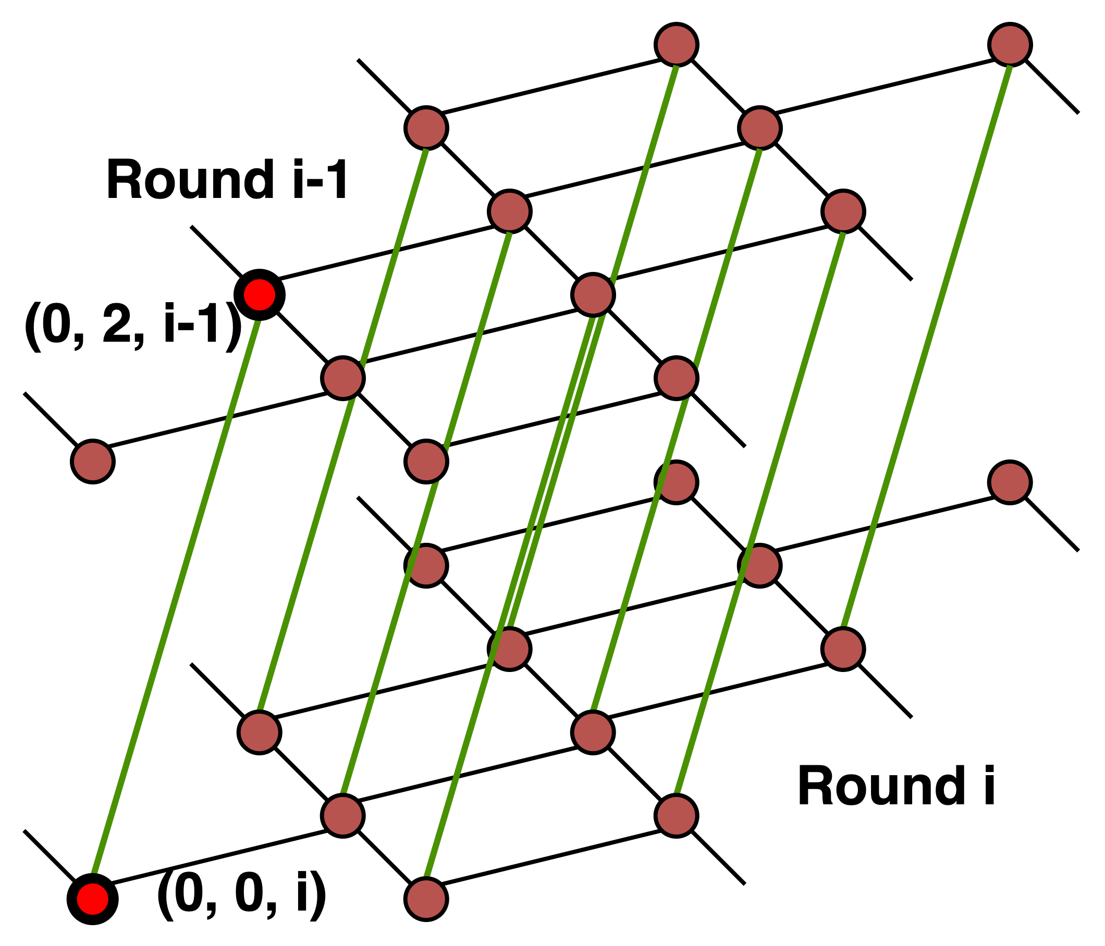
Deriving Hook-like Edges

Slide 21
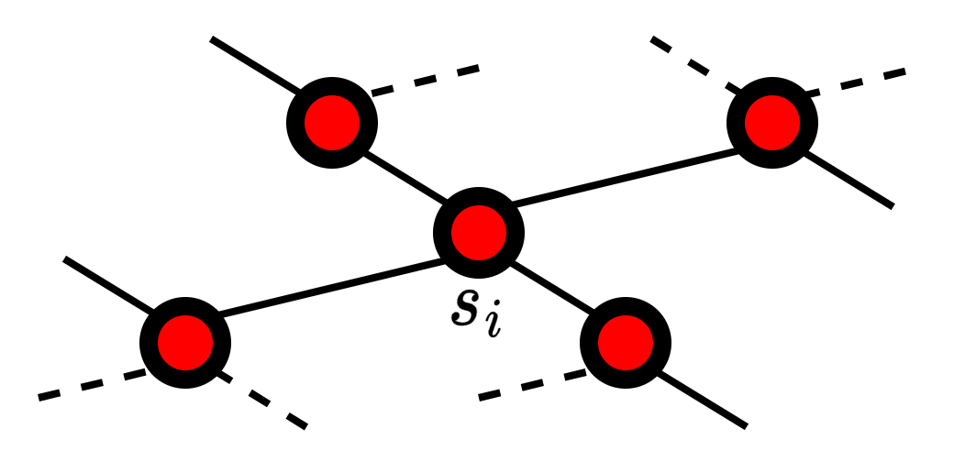
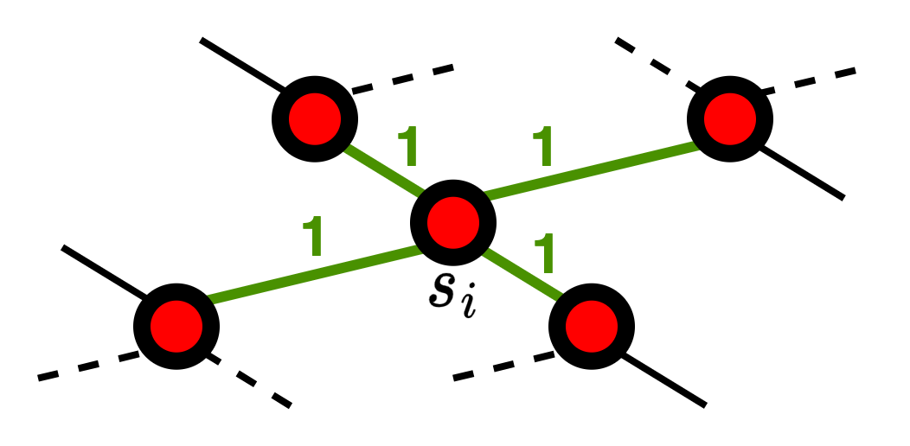
Multiple Active Neighbors
Race condition: corrections are inconsistent with observed syndromes

Slide 22
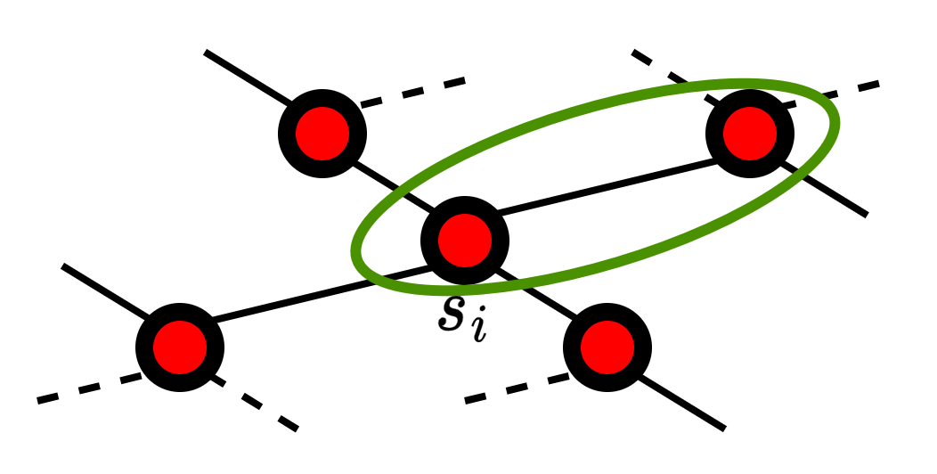
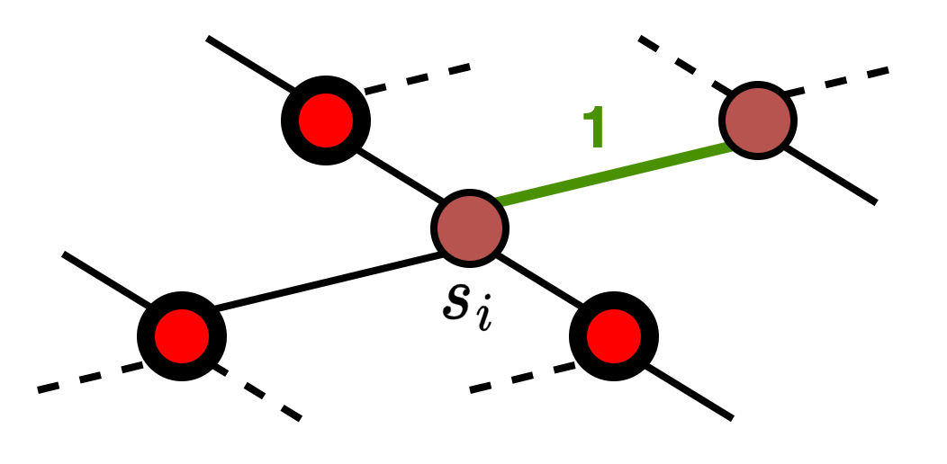
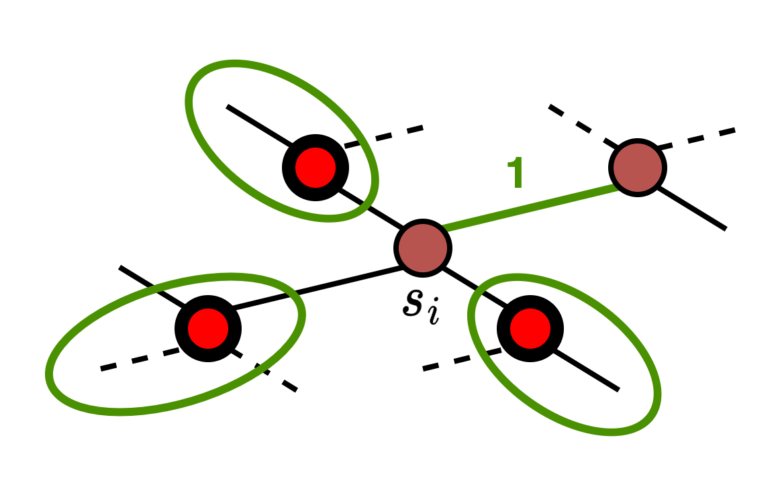
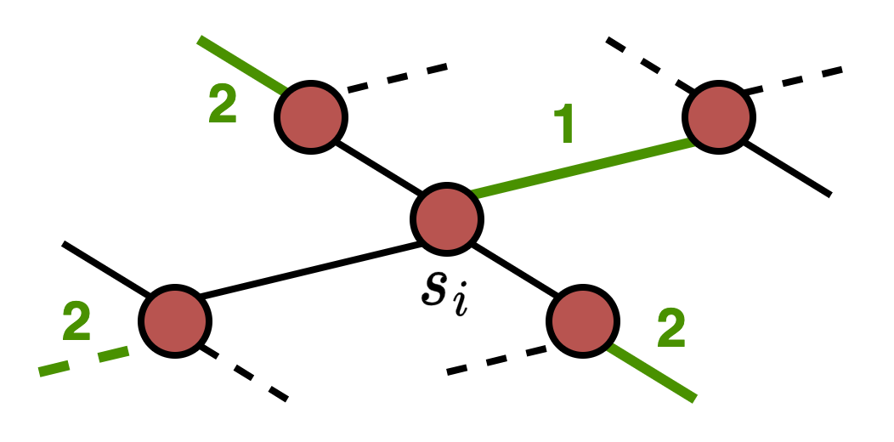
Multiple Active Neighbors
Solution:
Enforce ordering between conflicting predecoding primitives
Clear active syndromes when assigning corrections

Slide 23
Hardware Implementation

Slide 24
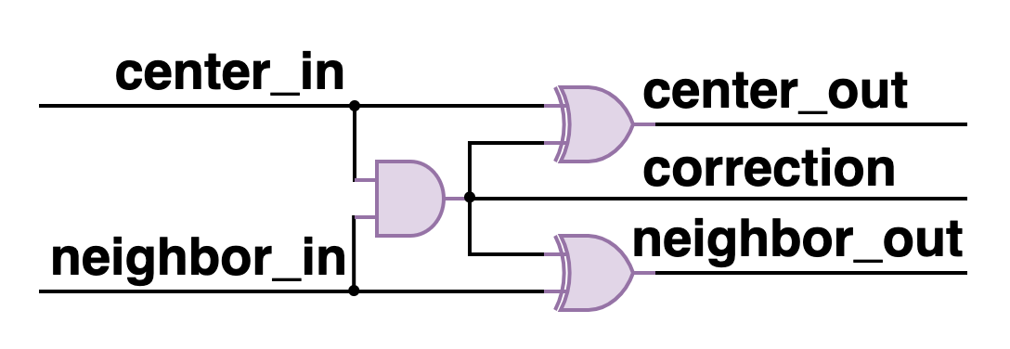
Predecoding Primitive
Functionality
If both syndromes in a pair are active, assign a correction to their edge
Clear the syndrome pair after assigning a correction

Slide 25
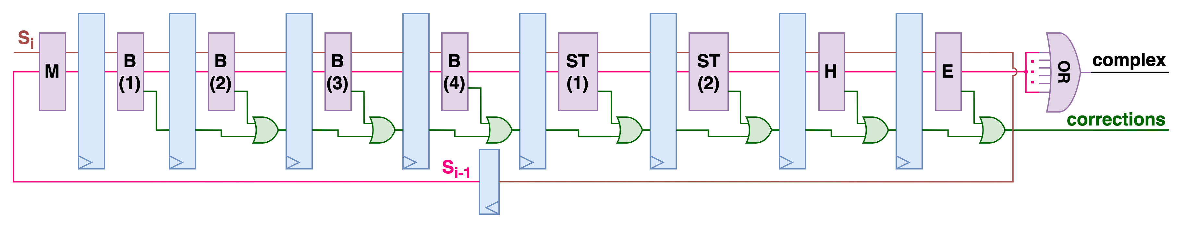
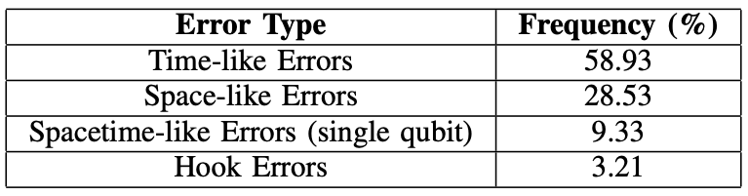
Pinball Pipeline
Functionality
Break race conditions by enforcing an ordering between conflicting predecoding primitives

Slide 26
Evaluation & Results

Slide 27
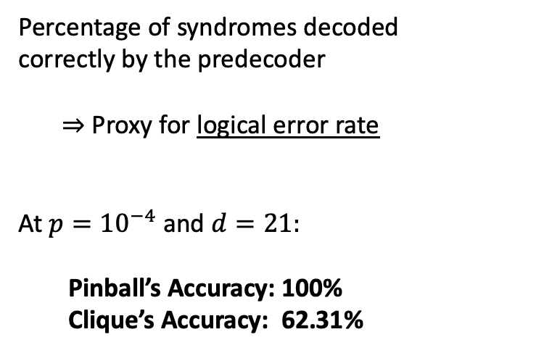
L1 Accuracy
L1 Accuracy
(%)
Percentage of syndromes decoded
correctly by the predecoder
⇒ Proxy for logical error rate
At $p={10}^{−4}$ and $d=21:$
Pinball’s Accuracy: 100%
Clique’s Accuracy: 62.31%

Slide 28
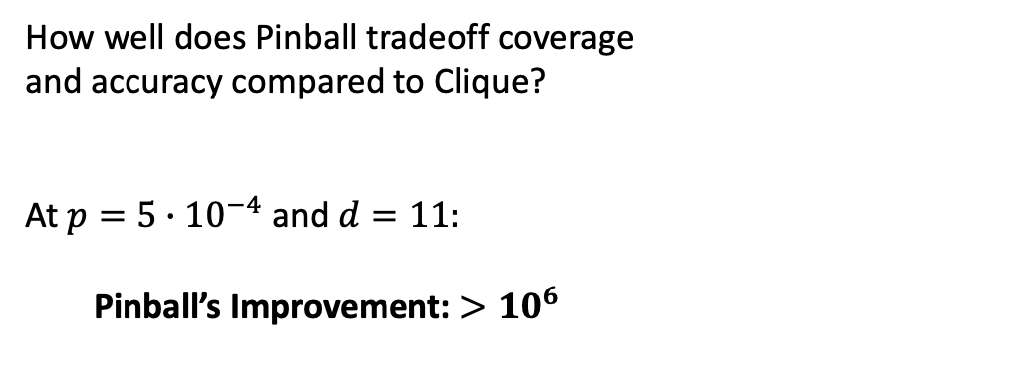
Logical Error Rate
Logical Error
Rate
How well does Pinball tradeoff coverage
and accuracy compared to Clique?
At $p={5∙10}^{−4}$ and $d=11:$
Pinball’s Improvement: ${>10}^{6}$
Pinball is the first cryogenic predecoder to enable exponential reduction in logical error rates under realistic noise

Slide 29
Logical Error Rate
Logical Error
Rate
How detrimental is it to introduce a
first-level heuristic decoding step?
Pinball maintains the required QEC performance for real quantum computing systems

Slide 30
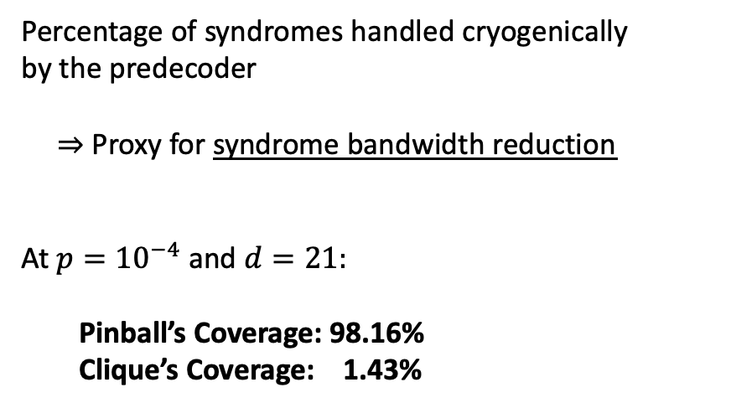
L1 Coverage
Percentage of syndromes handled cryogenically
by the predecoder
⇒ Proxy for syndrome bandwidth reduction
At $p={10}^{−4}$ and $d=21:$
Pinball’s Coverage: 98.16%
Clique’s Coverage: 1.43%
L1 Coverage
(%)

Slide 31
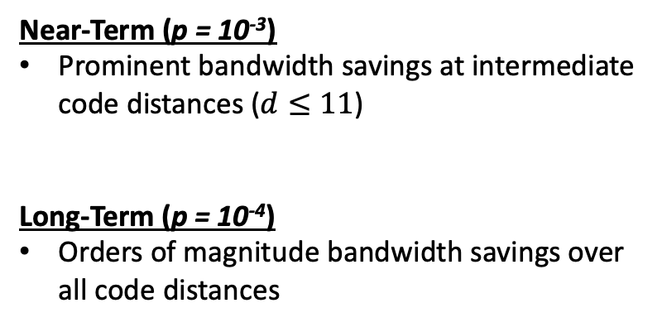
Bandwidth Savings
Near-Term (p = 10⁻³)
Prominent bandwidth savings at intermediate code distances ($d≤11$)
Long-Term (p = 10⁻⁴)
Orders of magnitude bandwidth savings over all code distances
Bandwidth
Savings

Slide 32
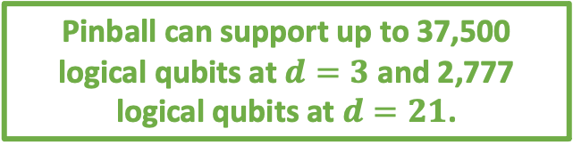
Energy Savings
Total Energy = Syndrome Transmission Energy + Cryogenic Hardware Energy
Pinball ↓ ↑
Near-Term (p = 10⁻³)
Pinball: max 15.06x savings
Long-Term (p = 10⁻⁴)
Pinball: max 39.06x savings
Energy
Savings
Pinball can support up to 37,500 logical qubits at $d=3$ and 2,777 logical qubits at $d=21$.

Slide 33
Key Takeaways
QEC circuit- and application-level analysis reveals critical design optimizations that circumvent key system bottlenecks
Pinball decreases logical error rate and syndrome bandwidth by several orders of magnitude relative to prior SOTA
⇒ First demonstrated cryogenic predecoder suitable to realistic noise
Application-hardware codesign enables Pinball to achieve energy savings for any target physical error rate or code distance
⇒ Enables scalability to large numbers of logical qubits within cryogenic operating constraints
Scan to read the paper!

Slide 34
Thank You For Listening!

